Slide 1
Evaluating the Impact of Training on Provider Efficiency
Sarah Dawson, Amanda Edwards
Liz Hall, Stacy Moore, Mackenzie Szudlo

Slide 2

Introduction
Why Clinical Efficiency Matters
Clinical Efficiency is about more than just saving time -
it’s the foundation of a functional, sustainable healthcare system
Supports Provider Well-Being
Helps reduce burnout and improves job satisfaction.
Improves Patient Experience
Faster, more focused care with fewer delays.
Drives Financial Outcomes
Tied to major incentives like Epic Honor Roll participation.
Enhances System Performance
Efficiency across the board leads to smoother operations for all.
Our Goal:
This project aims to evaluate provider training programs to determine what works, what doesn’t, and why it matters.

Slide 3
Background and Context
Understanding The Real-World Impact of EHR Training
The Challenge Facing Academic Medical Centers
Rising pressure to deliver high-quality care
Staffing shortages and documentation complexity
EHR systems like Epic can add burden when not optimized properly
A Unique Opportunity at OSUWMC
Access to Epic Signal—detailed usage data on provider EHR behavior
Ability to cross-reference with internal training records
A chance to move beyond assumptions and evaluate impact with rigor
Training: Common, but Often Unevaluated
Organizations invest in EHR training (onboarding, refreshers, deep dives)
Many rely on anecdotal feedback and success stories over measurable outcomes
Bottom Line
Epic (EHR) efficiency is tied to
clinical performance and financial incentives
Understanding which training efforts improve key metrics helps guide future investments and elevate system-wide performance

Slide 4

Honor Roll Metrics: Provider Efficiency
Messaging | Time in In Basket per Appointment Messages Received per Day
Ordering | Time in Orders per Appointment Orders with Unchanged Defaults
Note Writing | Time in Notes per Appointment Progress Note Length
Chart Review | Time in Clinical Review per Appointment
Notes:
Epic offers Honor Roll, an incentive program that rewards institutions meeting best practice thresholds with discounts and enhanced support. Honor Roll covers many aspects of EHR use, but we have chosen to focus our project on provider efficiency. There are four categories that Epic evaluates related to provider efficiency:
Messaging between providers and staff within Epic (via a tool called the In Basket)
Placing orders for medications, procedures and services
Writing notes within patient charts to document care provided
Reviewing patient charts to get up to date on medical history, current problems, and current treatments
Each category has a metric that measures the provider’s time spent in that activity, normalized against how many appointments that provider performed during the reporting period. This normalization to per appointment helps us to compare across providers, some of whom see only a few patients while others see many patients.
There are two additional metrics that address how easy or hard it is for providers to do their jobs in Epic. The first, Orders with Unchanged Defaults, measures how many orders the providers can enter simply by selecting a medication or procedure and having the correct details (like medication dose/route/frequency) default in. The second, Progress Note Length, measures how long the provider’s notes are.

Slide 5
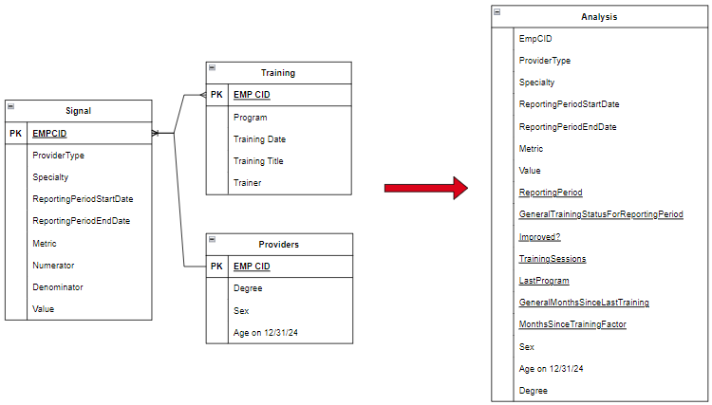
Data
Notes:
We used three separate data sets for our analysis.
Mackenzie mentioned the first: Epic’s Signal data provides a monthly report of each metric for each provider.
The IHIS training team provided a history of training sessions taken by each provider.
We obtained additional dimensions about individual providers from IHIS records.
The common thread between these data sets was EMP CID, a unique identifier for each provider. We cleaned and combined the datasets so that our analysis dataset contained one row per provider per metric per reporting period. We added “helper” columns (underlined in this screenshot) that allowed us to analyze:
the provider’s training status
whether the metric improved
how many training sessions the provider had taken
which program the provider took last
and how much time had past since the provider’s last training

Slide 6
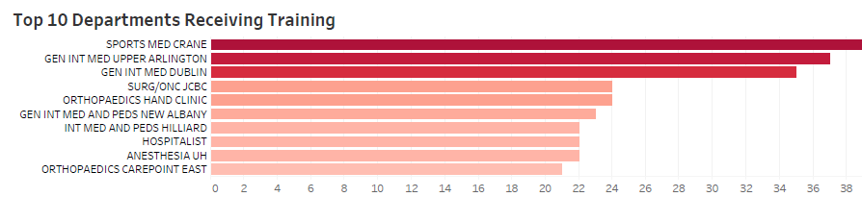
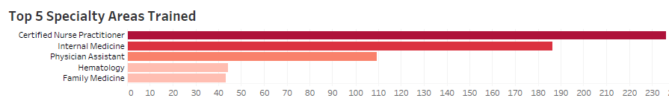
Training population
Departments and Specialties
Most sessions taken in Sports Medicine Jameson Crane location. General Internal Medicine in UA and Dublin also very high.
Other internal medicine departments in New Albany and Hillard among the top 10.
Certified Nurse Practitioners are the largest areas taking training and are heavy EPIC users.
Consistent with chart above, internal medicine is the second highest followed by physician assistants.
Sharp decline in the other areas for hematology and family medicine.

Slide 7

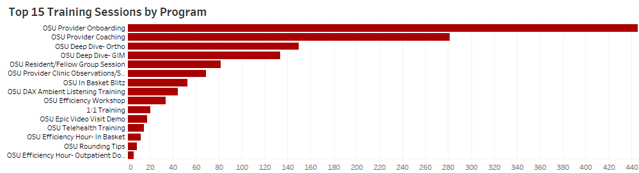
Training programs
Which programs are ‘popular’?
Popular current programs provide an immediate opportunity make an impact.
Onboarding and provider coaching account for nearly 50% of the top 15 training sessions. Follows a hiring trend with new locations.

Slide 8
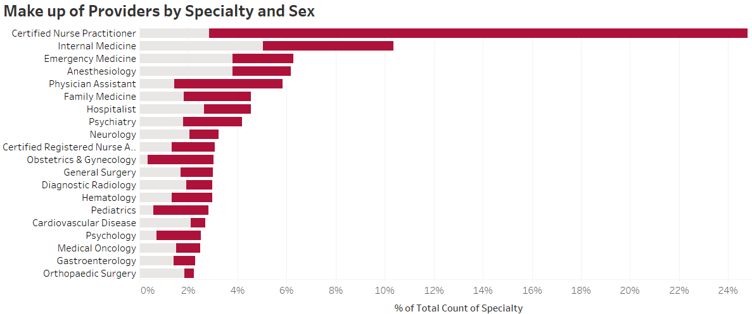

Provider Demographic
What can we tell about the provider groups?
Certified Nurse Practitioners are by far the largest provider group—both in terms of overall size and training participation.
CNAs and other high training participation groups including physician assistants are predominantly female.

Slide 9
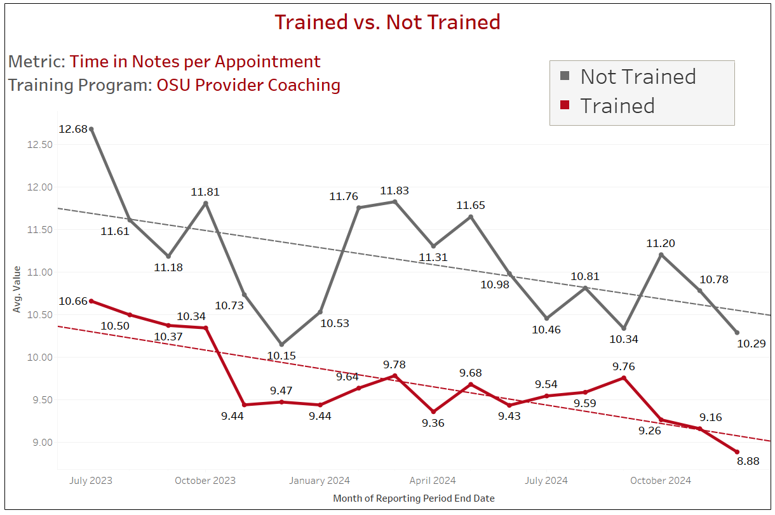
Impact of Provider Training
Trained versus Untrained Providers:
Assessed impact of Trained versus Not Trained providers on metric values
Significant improvement in the Trained group appeared in:
Time in Orders - 0-2 months
Time in Notes - 3-5 months
Time in Clinical Review - 6+ months
No difference in Time in In Basket per Appointment or Unchanged Defaults from Preference List

Slide 10
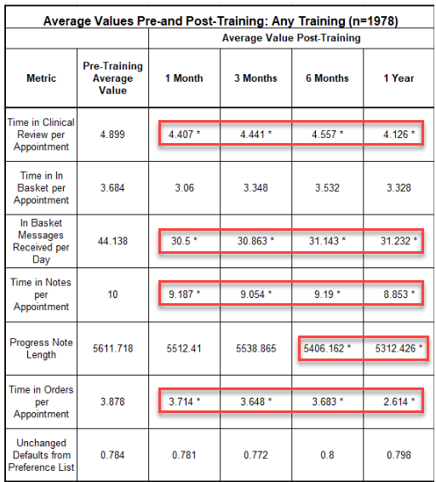
Do Training Programs Improve Efficiency Metrics?
Effect of providers who took ANY training program
on the value of Honor Roll Metrics (i.e. efficiency metrics)
Significant within-group changes noted for:
Time in Clinical Review per Appointment
In Basket Messages Received per Day
Time in Notes per Appointment
Time in Orders per appointment
Progress Note Length (after 6+ months)
No significant change:
Time in In Basket per Appointment
Unchanged Defaults from Preferences List

Slide 11

Key Findings
Statistically Significant Improvements: Training programs at OSUWMC are linked to measurable gains in EHR efficiency, especially in documentation (shorter progress notes, reduced time in notes) and inbox management.
Targeted Training Yields Strongest Results: Efficiency gains are most pronounced when training emphasizes personalization and SmartTools; some metrics (e.g., clinical review efficiency) show improvement after several months, indicating a learning curve.
Nuanced Outcomes: Not all metrics improved equally. For example, trained providers spent more time in In Basket per appointment, which may reflect higher engagement or message volume, rather than inefficiency.
Demographic and Specialty insights: Certified Nurse Practitioners (CNPs) and Internal Medicine providers are the most engaged in training; Emergency Medicine is underrepresented, presenting an opportunity for targeted outreach.
Notes:
As Amanda mentioned our primary finding is that provider training generates statistically significant improvements across most metrics. Targeted training emphasizing personalization and Smart Tools yields strongest results. Some metrics didn’t show improvement until few months post training indicating a learning curve in implementing training. The metric outcomes did not change equally with some metrics showed no improvement. This is not necessarily an inefficiency but could be higher engagement or message volume rather for inefficiency. Finally, CNPs and Internal Med providers are the most engaged. CNPS make up a large portion of the workforce and are predominantly female.

Slide 12
Recommendations and Next Steps
Recommendations
Prioritize High Impact Specialties: Focus on future training on Honor Roll Specialities to maximize institutional benefit.
Engage Underrepresented Specialties: Develop specialty-specific modules and outreach for less-engaged specialities.
Leverage Demographic Insights: Increase engagement by aligning training materials and communications with the predominantly female provider workforce.
Deepen Analysis To Enrich Insights: Update “trained” provider definitions to include prior training and use provider feedback to tailor future programs.
Monitor & Adjust: Continue monitoring providers’ efficiencies pre and post training data to evaluate the impact of training adjustments. Use findings to refine and optimize training programs.
Next Steps
Investigate Root Causes for Stagnant Metrics: Conduct targeted analysis on “Time in In Basket per Appointment” and “Unchanged Defaults from Preferences List (Orders with unchanged defaults)” to identify workflow barriers, training gaps, or system design issues.
Obtain Provider Feedback: Perform prescriptive analysis to assess provider perceptions on training programs and EHR efficiency to enhance provider engagement, ensuring future offerings are both data-driven and responsive to provider needs.
Incorporate Additional Historical Data: Accurately assign provider training status and analyze impact of multiple trainings on efficiency.
Partner with Finance and Operations Departments: Quantify efficiency savings through revenue from increased patient capacity and Epic rebates tied to EPIC Honor Roll performance.

Slide 13
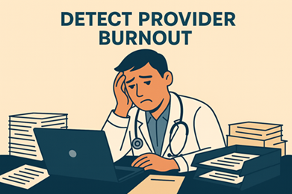
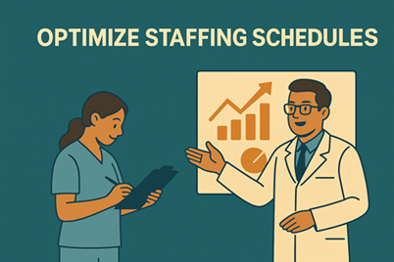
Additional Takeaways
Detect Provider Burnout Through EHR Metrics: Leverage Signal data to identify potential burnout indicators like "Time Outside Scheduled Hours," "Pajama Time" (after-hours EHR usage), and "Time on Unscheduled Days." These metrics—when correlated with workload patterns (e.g., In Basket volume)—could flag at-risk providers for targeted support interventions.
Optimize Staffing Schedules Using Efficiency Trends: Analyze peak workload times (e.g., In Basket message surges) and specialty-specific efficiency patterns (e.g., chart review duration) to align staffing with demand. Predictive models can forecast high-volume periods, enabling proactive schedule adjustments that reduce burnout risk and improve workflow balance.

